Slide 1


Hend Khaled Aly
Mario Habib Fathy
Suhaila Ahmed
Rowaina Reda
16th March 2025

Slide 2
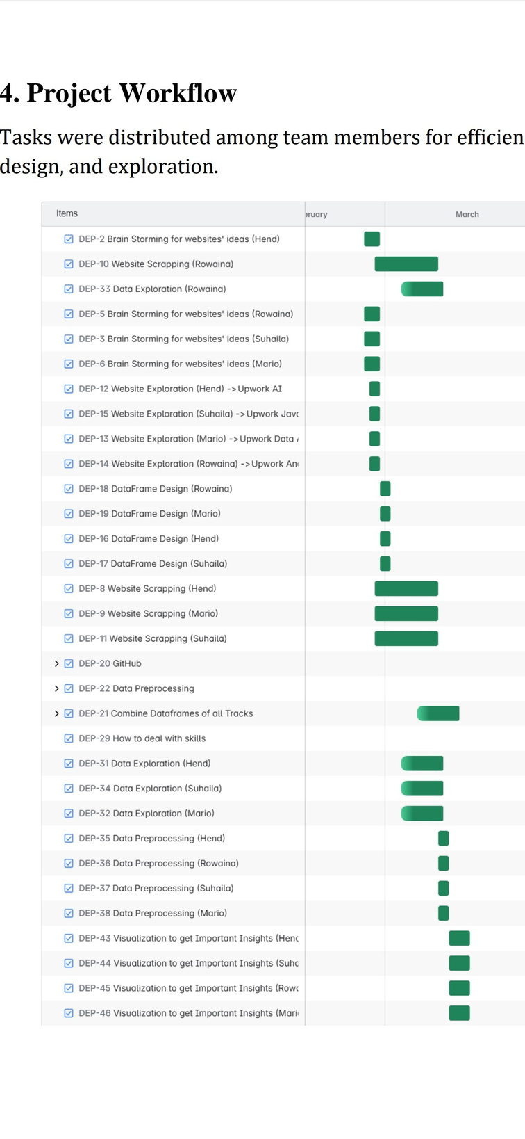
TABLE OF CONTENT
01
Objective
02
Data Collection
03
Data Preprocessing
04
Data Insights & Visualizations
05
Limitations
06
Conclusion

Slide 3
Objective
1. Market Research & Trend Analysis
Identify in-demand skills and job categories.
Understand which industries are most active on Upwork.
2. Pricing & Budget Analysis
Analyze average budget for various projects.
Help freelancers price their services competitively.
3. Client Behavior & Job Posting Patterns
Study client preferences and hiring tendencies.
Detect geographic trends in job postings.
4. Freelancer Performance & Competition
Understand what can make a freelancer stand out.
Understand what factors lead to higher hire rates.

Slide 4

Data
Collection

Slide 5




Android Developer
AI Engineer
Job Profiles
Data Analyst
JavaScript Developer

Slide 6
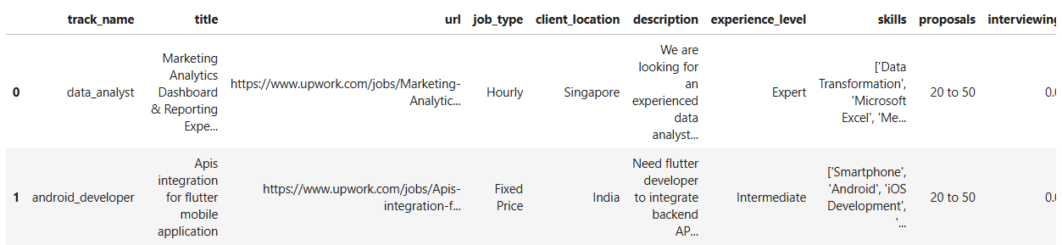
DATA OVERVIEW BEFORE PREPROCESSING
Data Source: Upwork Site
Data Aquisition: Data was scrapped from the job postings page on Upwork
Records: 3966 (1000 record per job profile)
Features: 20

Slide 7
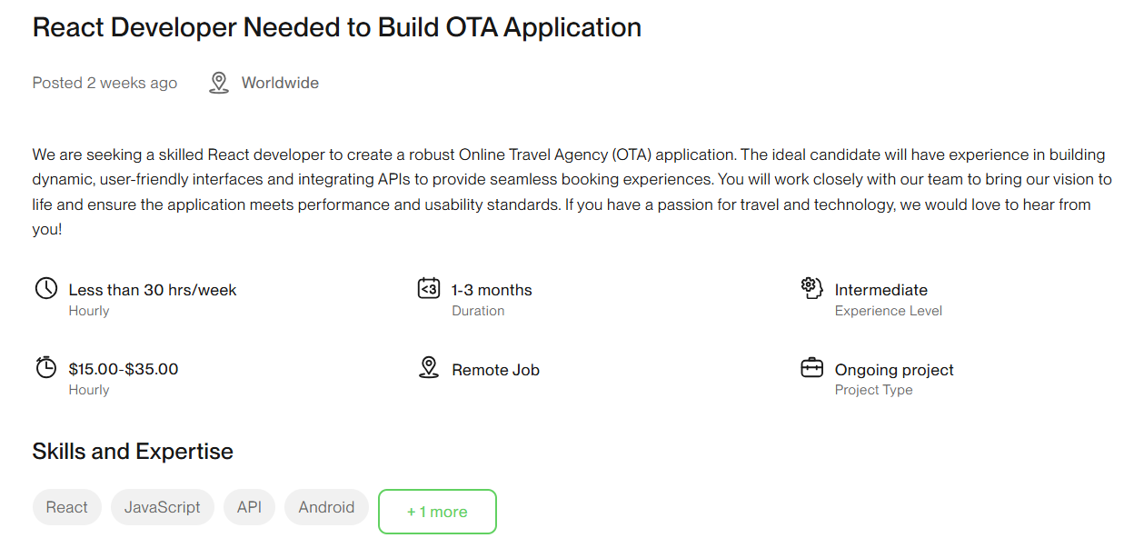
Title

Slide 8
Description

Slide 9
Job Type

Slide 10
Work Hours

Slide 11
Duration

Slide 12
Experience Level

Slide 13
Min-Max Budget

Slide 14
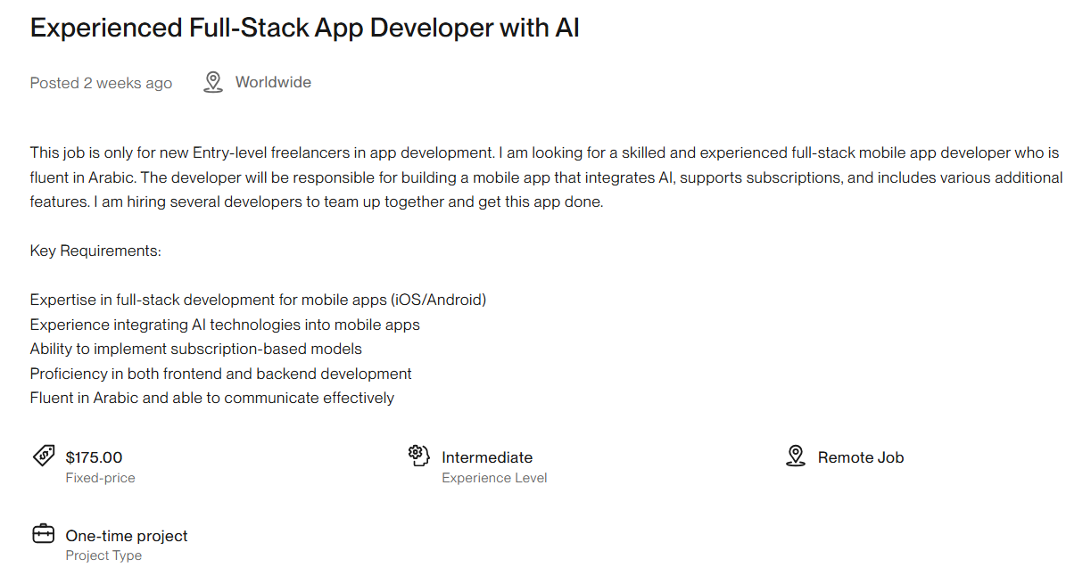
Fixed Budget

Slide 15
Skills

Slide 16
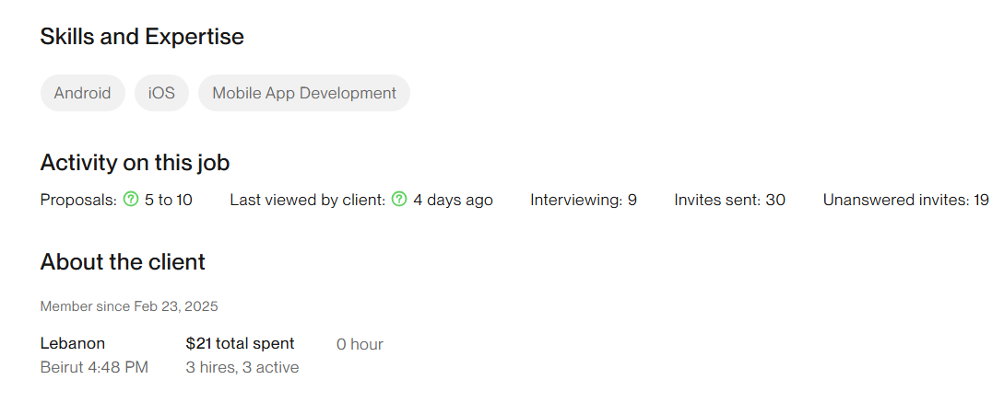
Proposals

Slide 17
Interviewing

Slide 18
Invites Sent

Slide 19
Unanswered Invites

Slide 20
Client Location

Slide 21
Client Total Spent

Slide 22
Hires
Active

Slide 23
Additional Data
Job Track
Job URL

Slide 24

Data
Exploration

Slide 25


Question
Is a Job Posting Unique to a Specific Job Profile?

Slide 26
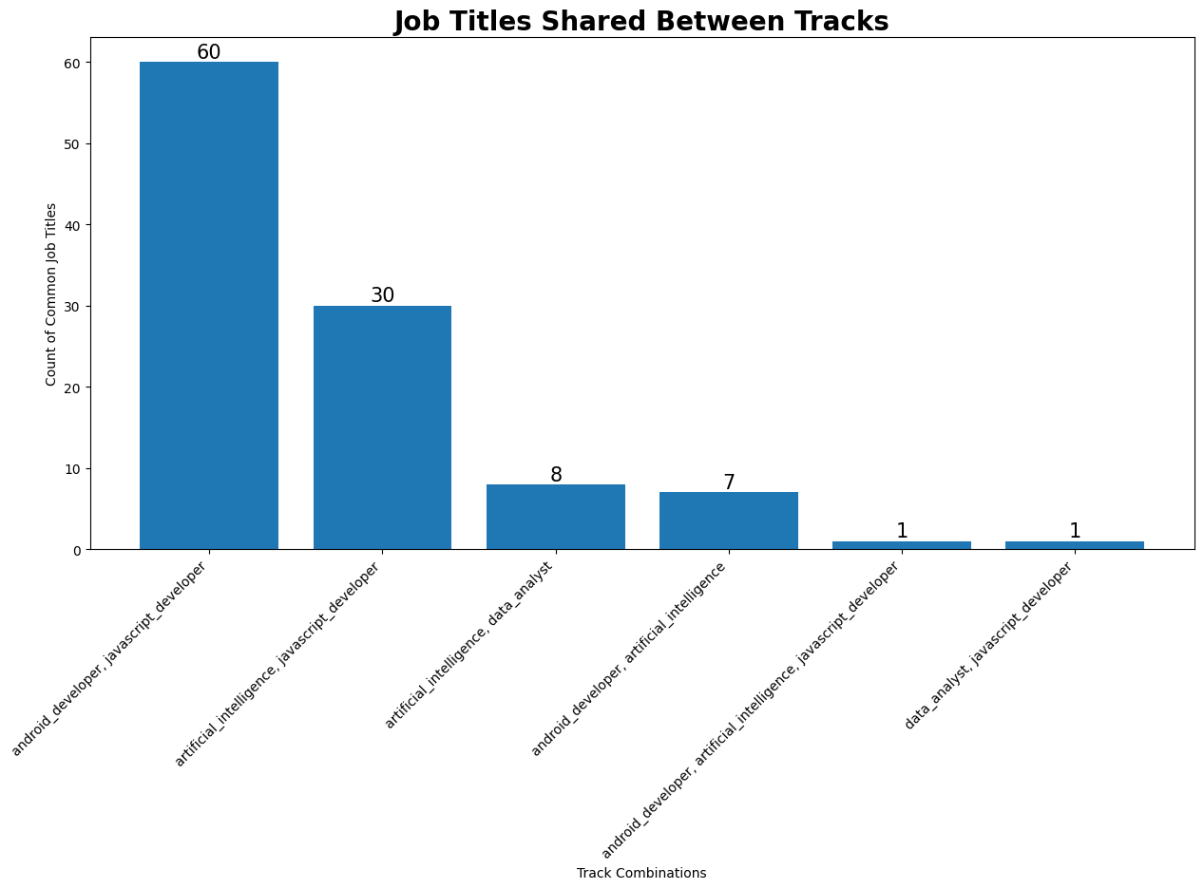
This bar graph shows the number of times that a job was posted at least twice under two or more of the job profiles we picked.

Slide 27
Insights
Same job can be posted under multiple job profile.

Slide 28
Question
Can the Missing Data Values Tell Us Something?

Slide 29
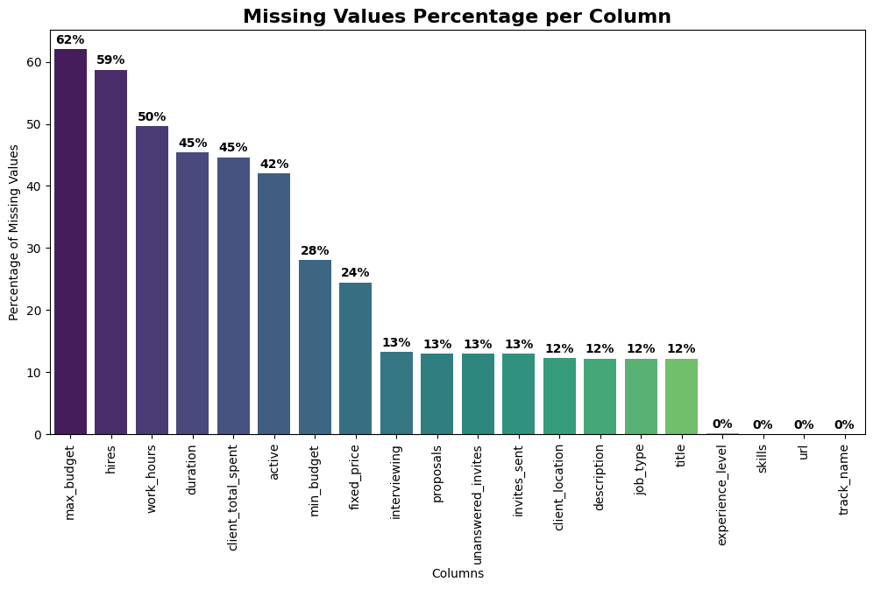

Slide 30
The percentage of missing titles is more than job URLs

Slide 31

Answer
Upwork gives the client the option to post a job under a private listing to limit the number of submissions

Slide 32
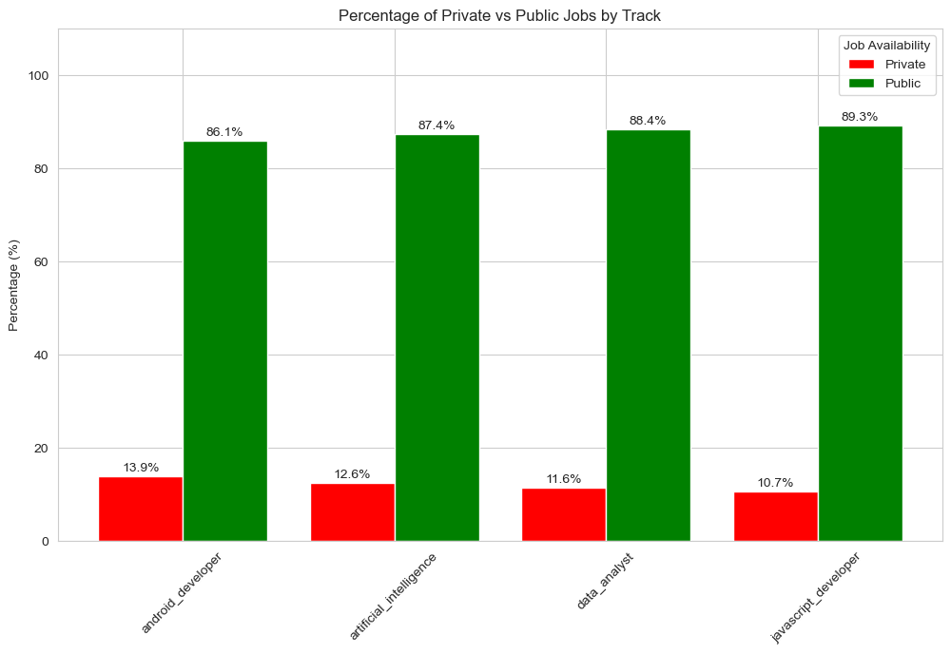
For every job profile, the percentage of private jobs are between 10-15%.

Slide 33
Not all clients provide a min hourly salary

Slide 34
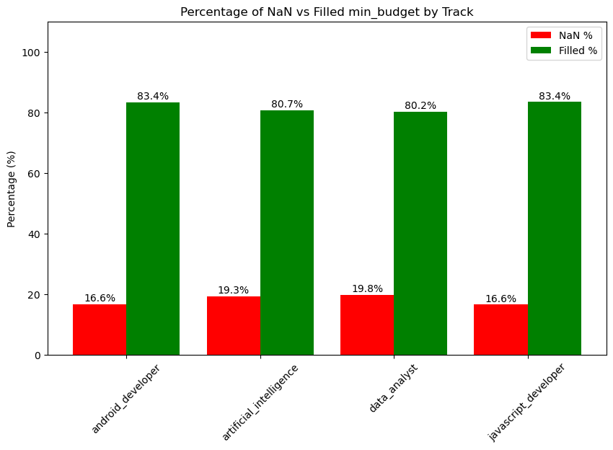
Insight
For every job profile we picked the percentage of hourly jobs without a min hourly salary is around 16-20% of all job postings

Slide 35

Data
Preprocessing

Slide 36
GOAL
Get as much clean Records as we can
Equal number of records for each job profile
Records should contain as less NaNs as possible

Slide 37
Title

Slide 38
Title

Slide 39
Title
Since missing values for job titles is due to the job being Private and there are common job titles between many jobs profiles
Drop records with missing and/or duplicate titles
Records Remaining: 3265

Slide 40
NaNs Column

Slide 42
Min & Max Budget

Slide 43
Max Budget
Min Budget

Slide 44
Min-Max Budget
NOTE:
Min budget: Holds min budget for Hourly Jobs and Fixed-Price budget
Max budget: Holds max budget for Hourly Jobs NaNs for Fixed-Price.
This explains the large number of NaNs in max budget column.

Slide 45
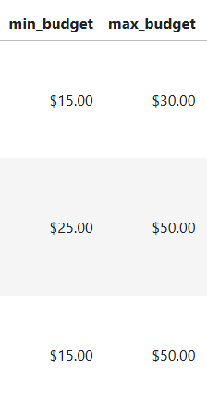
Min-Max Budget
Convert the min and max budget values from string to numerical values.
Drop the `$` and `,` and convert the columns to be of type Float.

Slide 46
Min-Max Budget
Create an Average Budget Column
The column contains the average of min and max budget in case max budget is not NaNs.
If max budget is NaNs, it means that the job is of Fixed-Price and it contains min budget only.

Slide 47
Min-Max Budget
Lastly, drop min budget and max budget columns, since they are no longer useful.

Slide 48
Duration & Work Hours

Slide 49
Duration & Work Hours

Slide 50
Duration & Work Hours
Currently both columns contain 1214 NaNs

Slide 51
Duration & Work Hours
Currently both columns contain 1214 NaNs
The NaNs remaining are because Fixed-Price jobs don’t have a determined duration and/or works hours.

Slide 52
Duration & Work Hours
Currently both columns contain 1214 NaNs
The NaNs remaining are because Fixed-Price jobs don’t have a determined duration and/or works hours.
To fix this we fill:
Duration NaNs with `Contract`
Work Hours NaNs with `Flexible`

Slide 53
Client Total Spent

Slide 54
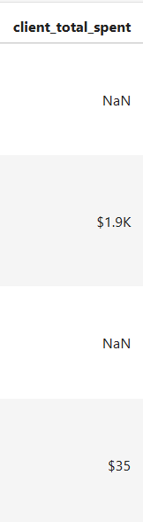
Client Total Spent
Convert Column from string to numerical values

Slide 55
Client Total Spent
Convert Column from string to numerical values
Remove `$` and `,`.

Slide 56
Client Total Spent
Convert Column from string to numerical values
Remove `$` and `,`.
If there is ‘K’ convert to Float and multiple by 1000

Slide 57
Client Total Spent
Convert Column from string to numerical values
Remove `$` and `,`.
If there is ‘K’ convert to Float and multiple by 1000
If there is ‘M’ convert to Float and multiple by 1000000

Slide 58
Client Total Spent
Convert Column from string to numerical values
Remove `$` and `,`.
If there is ‘K’ convert to Float and multiple by 1000
If there is ‘M’ convert to Float and multiple by 1000000
Else just convert the value to Float.

Slide 59
Client Location

Slide 60
Client Location
On checking the unique values for client location, we found that many clients write the abbreviations of their countries

Slide 61
Client Location
On checking the unique values for client location, we found that many clients write the abbreviations of their countries
Example:
United states -> US
United Kingdom -> UK, GBR

Slide 62
Client Location
To solve this problem, we mapped the country’s abbreviations to the country’s full names.

Slide 63
Client Location
To solve this problem, we mapped the country’s abbreviations to the country’s full names.
This ensures:
Consistency in formatting
Giving the accurate number of times a country appeared in data.

Slide 64
Client Location
Number of Countries before Mapping: 159 Countries
Number of Countries after Mapping: 105 Countries

Slide 65
Picking 2400 Records

Slide 66
Picking 2400 Records
In order to pick 2400 records (600 records per job profile), we dropped many records where the hires, active, min_budget and fixed_price (price) are NaNs.

Slide 67
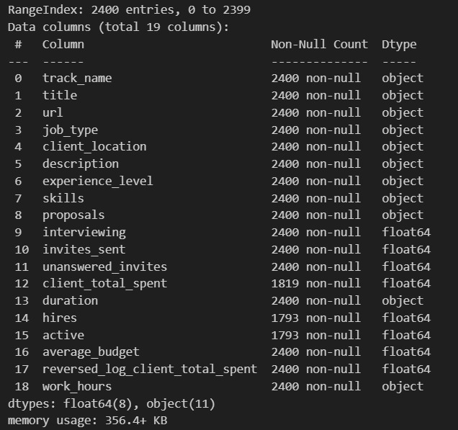
DATA OVERVIEW AFTER PREPROCESSING

Slide 68

Version Control

Slide 69
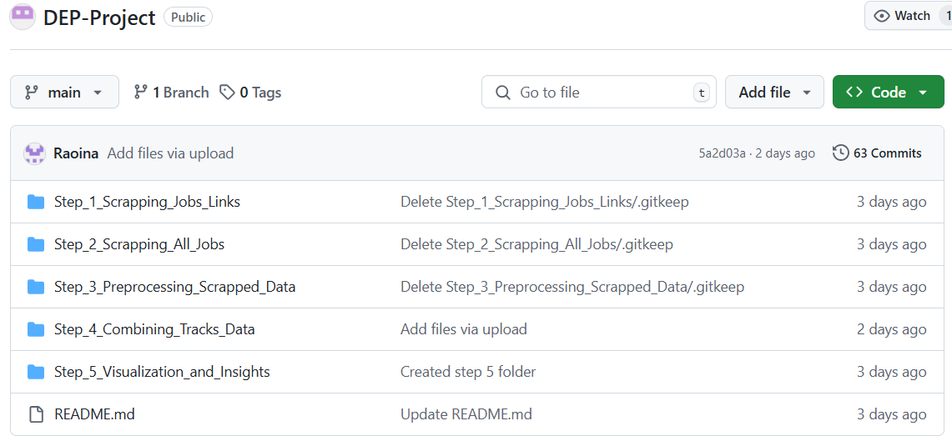

Slide 70
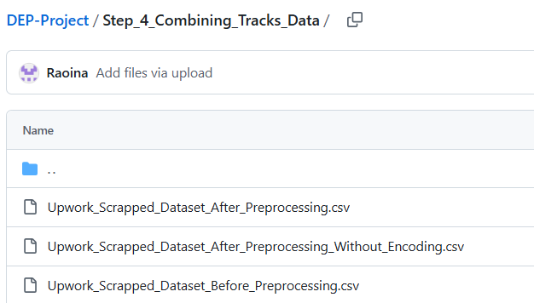

Slide 71
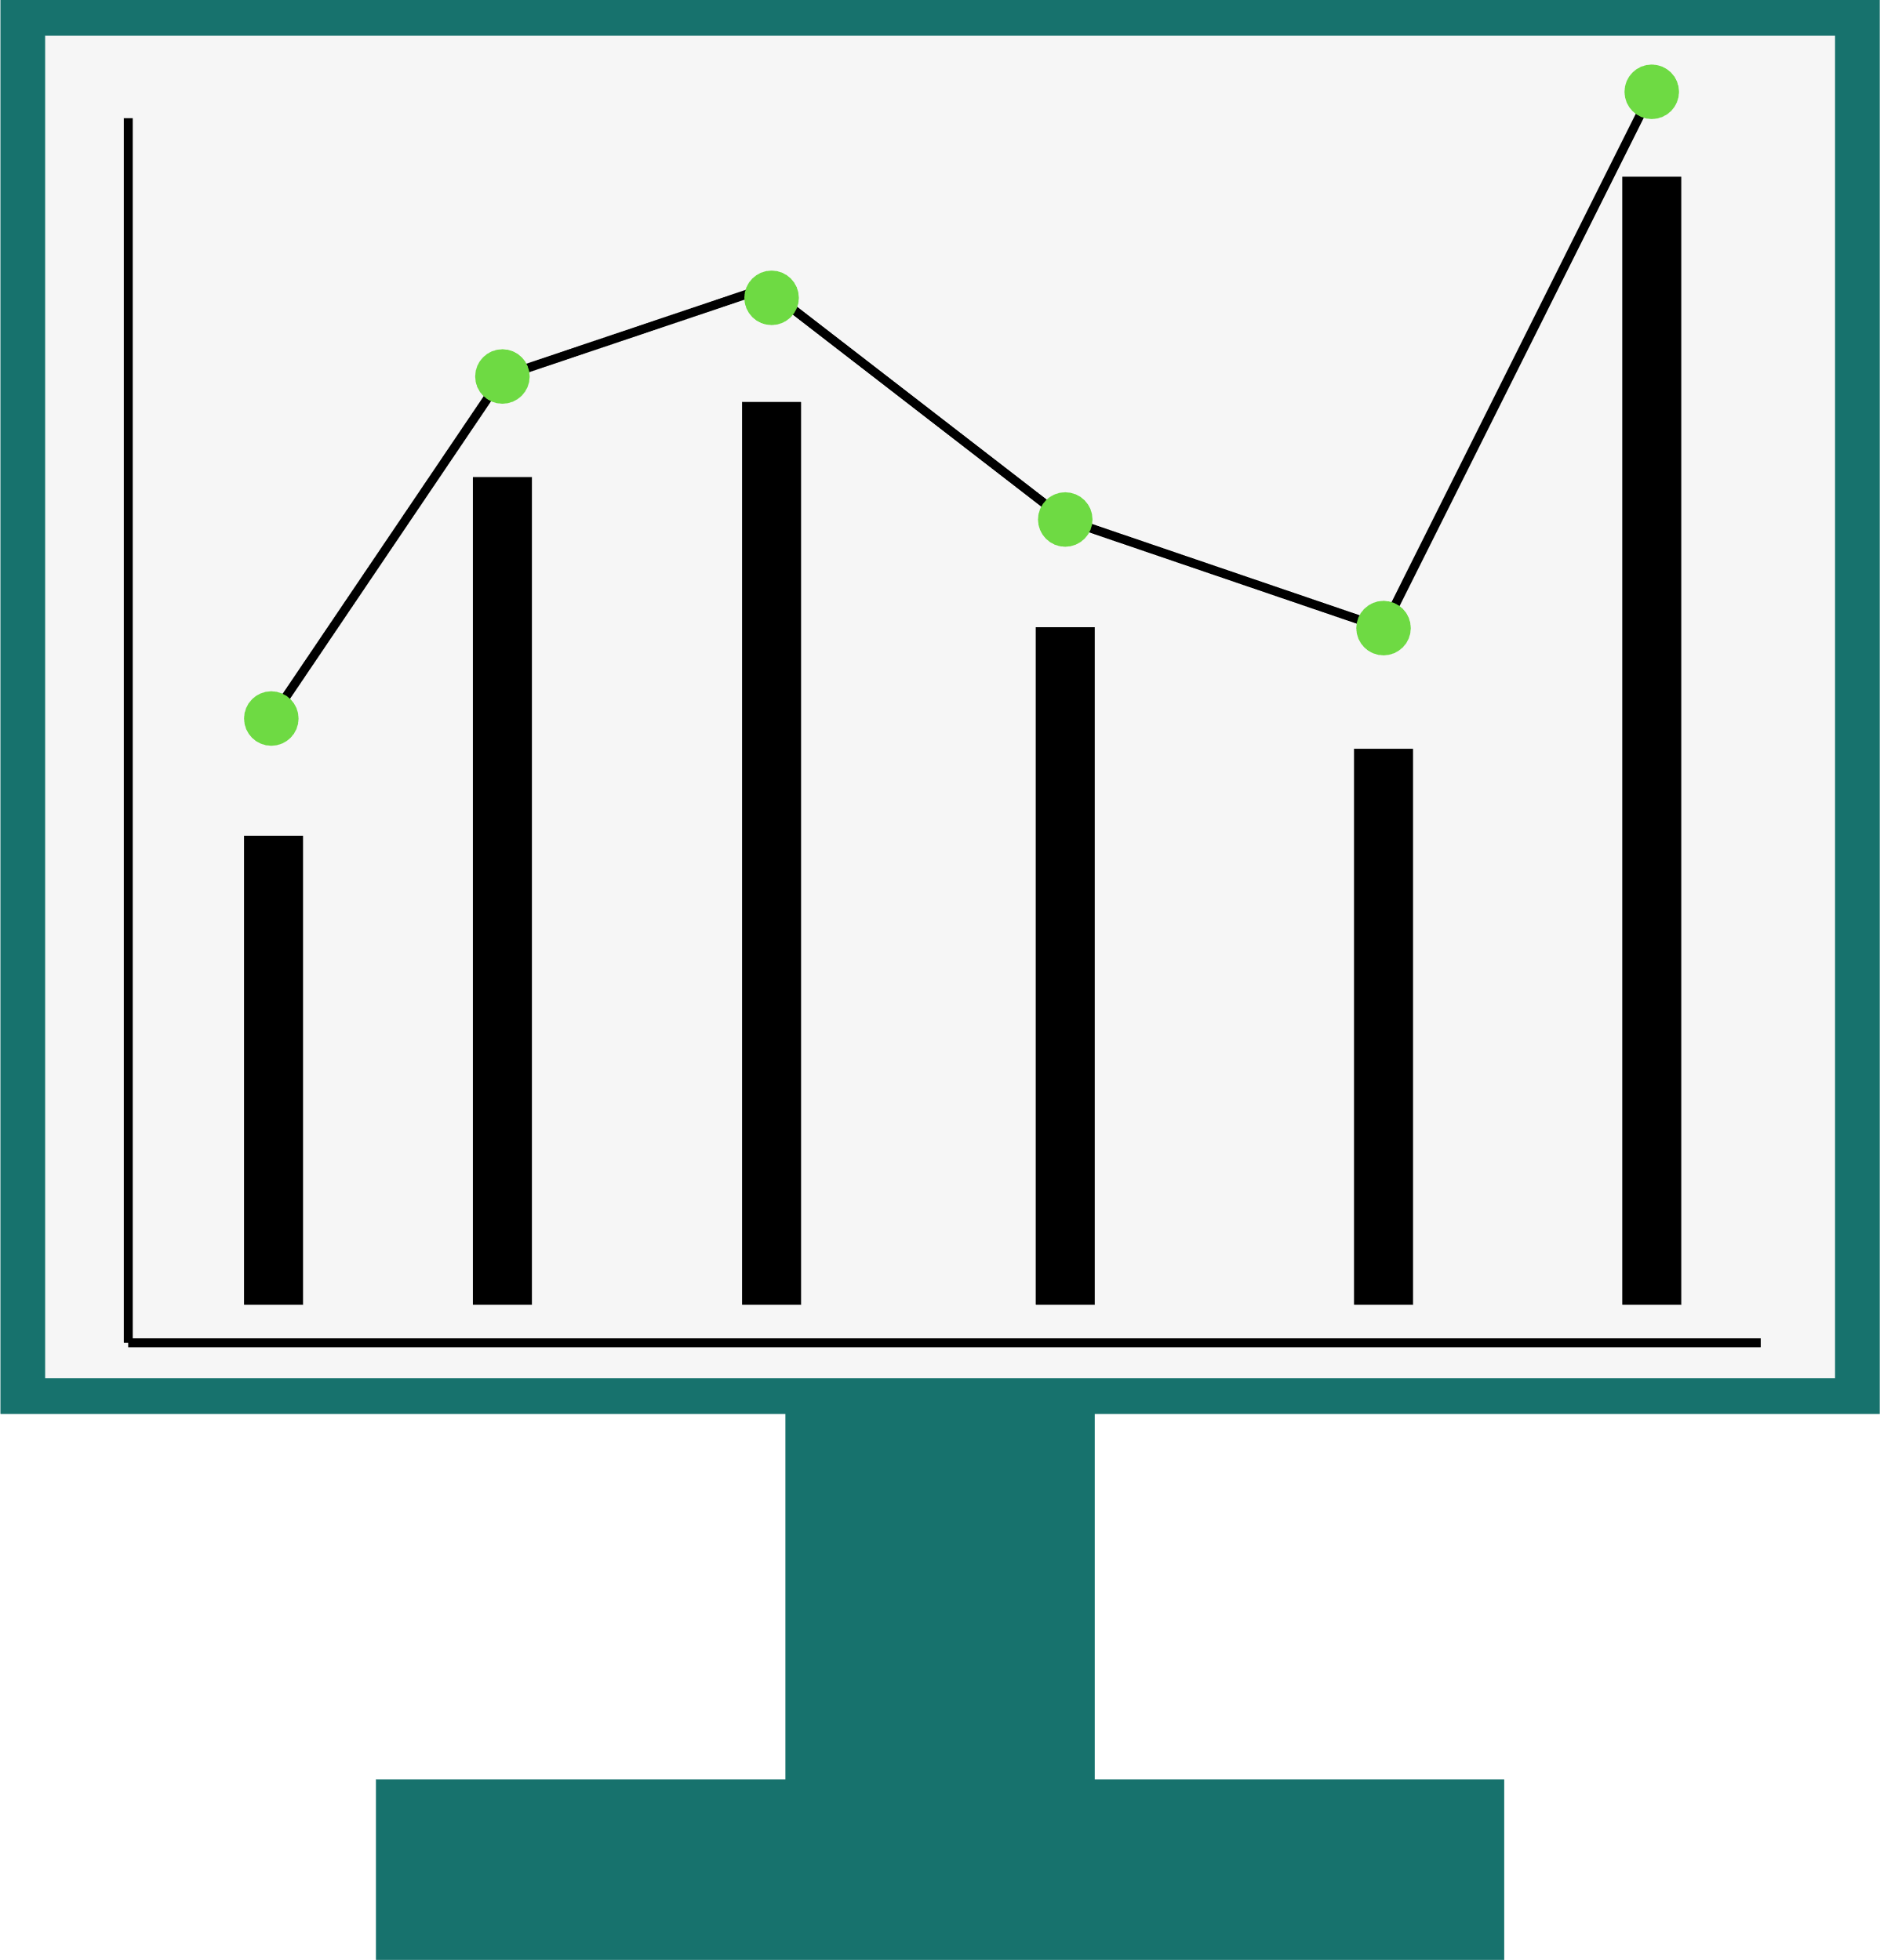
Data Insights
& Visualization

Slide 72
Question
Is There Any Correlation Between Features?

Slide 73
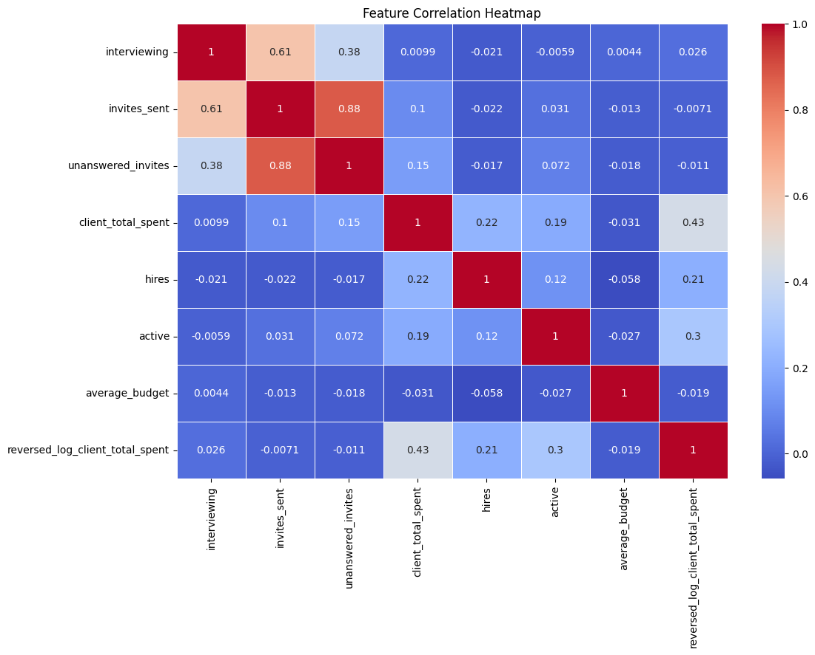

Slide 74
It might appear that there is a correlation between the interviewing, invites sent and unanswered invites columns.

Slide 75
It might appear that there is a correlation between the interviewing, invites sent and unanswered invites columns.
In reality, this is because most values in these columns are zeros, so they false sense that there is a correlation.

Slide 76
Insights
There is no correlation between the numerical features.

Slide 77
Question
Are Job Types Evenly Split Between Hourly & Fixed-Price?

Slide 78
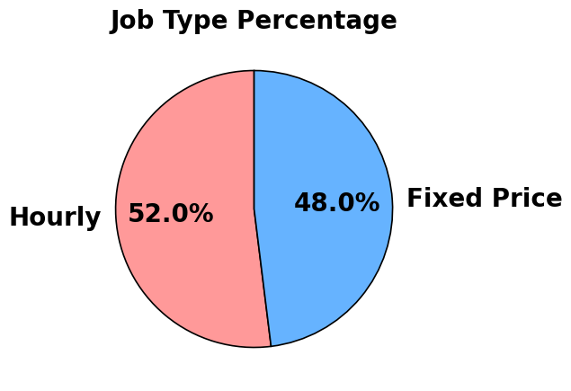

Slide 79
This is a pie graph representing the percentage of Hourly and Fixed-Price for all job profiles.
From the pie graph, it appears that job types are evenly split between Hourly and Fixed-Price

Slide 80
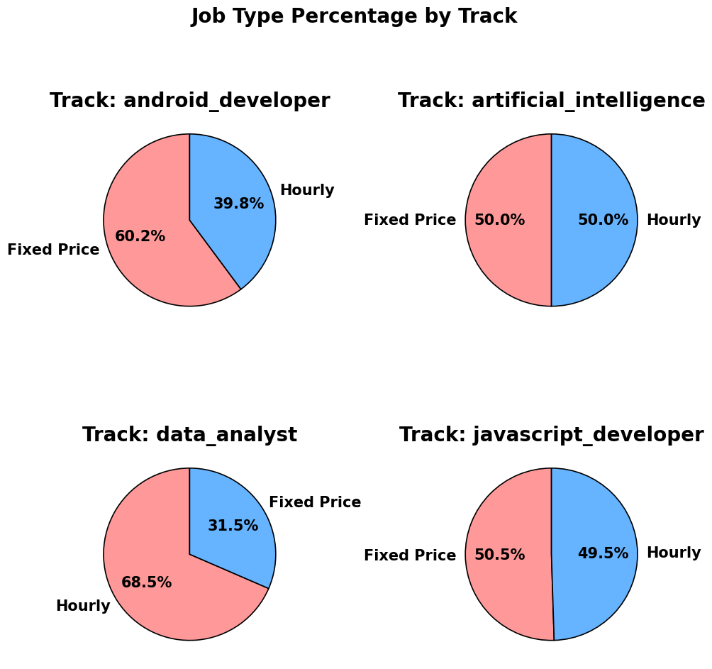

Slide 81
Insights
Job types are evenly split for AI engineers and JavaScript developers.
For android developers the split is 60% Fixed-Price and 40% Hourly.
For data analysts the split is 70% Hourly and 30% Fixed-Price.

Slide 82
Question
Is There a Relation between Experience Level, Job Types & Job Profiles?

Slide 83
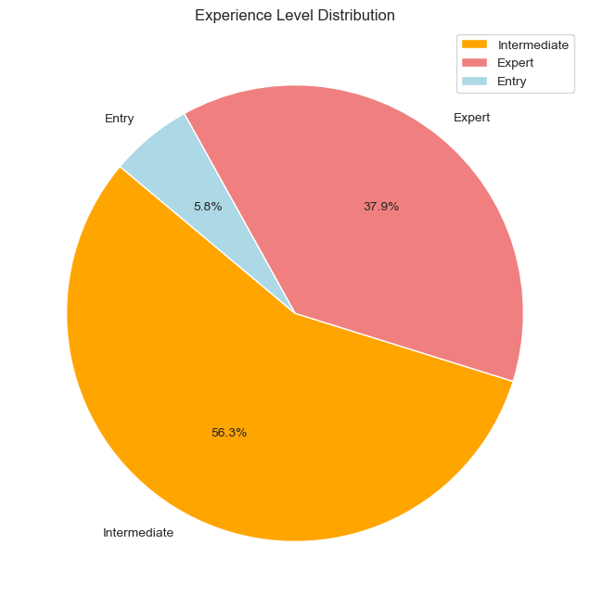

Slide 84
Insights
Most jobs are for Intermediate levels, followed by Experts and the least number of jobs require an Entry level.

Slide 85
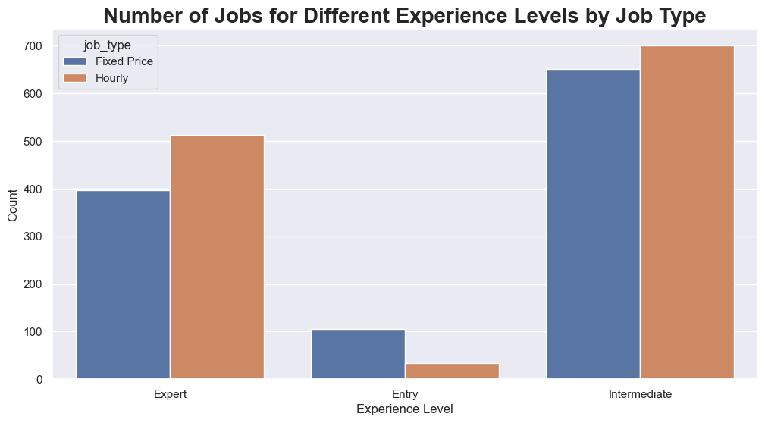

Slide 86
For different job types the same trend continues where Entry levels get the least number of jobs available

Slide 87
Number of Fixed-Price jobs for an Entry level is more than Hourly jobs.
This is opposite to Intermediate and Expert levels who have slightly more Hourly jobs to apply to.

Slide 88
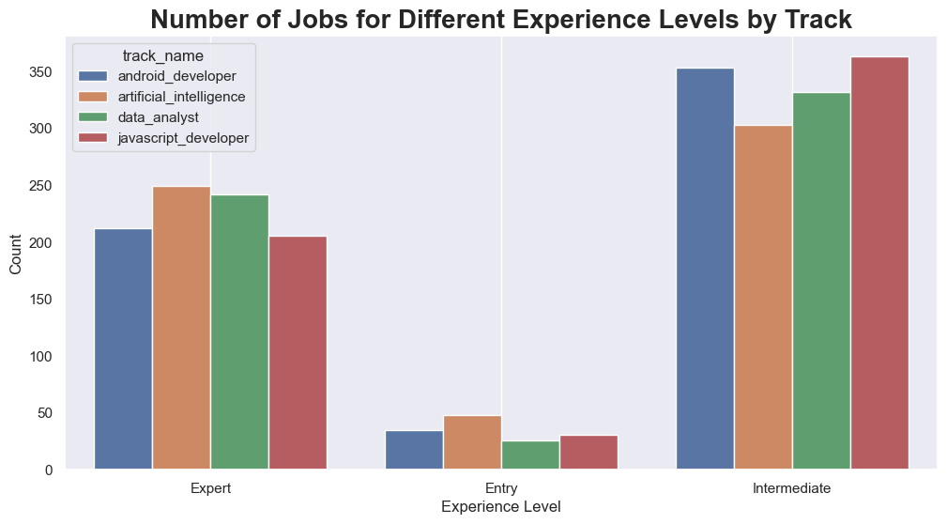

Slide 89
Insights
Number of jobs available for an entry level is significantly less than that available for those with higher experience level for every job profile.

Slide 90
Insights
Intermediate levels get the most job postings.
However, jobs for an intermediate level can still be done by an Expert, possibly making Experts have the greatest number of jobs to choose from.

Slide 91


Takeaway
When creating an Upwork Profile, it is better to have at Least Intermediate as your Experience Level

Slide 92
Question
What Affects the Number of Proposals a Job Gets?

Slide 93
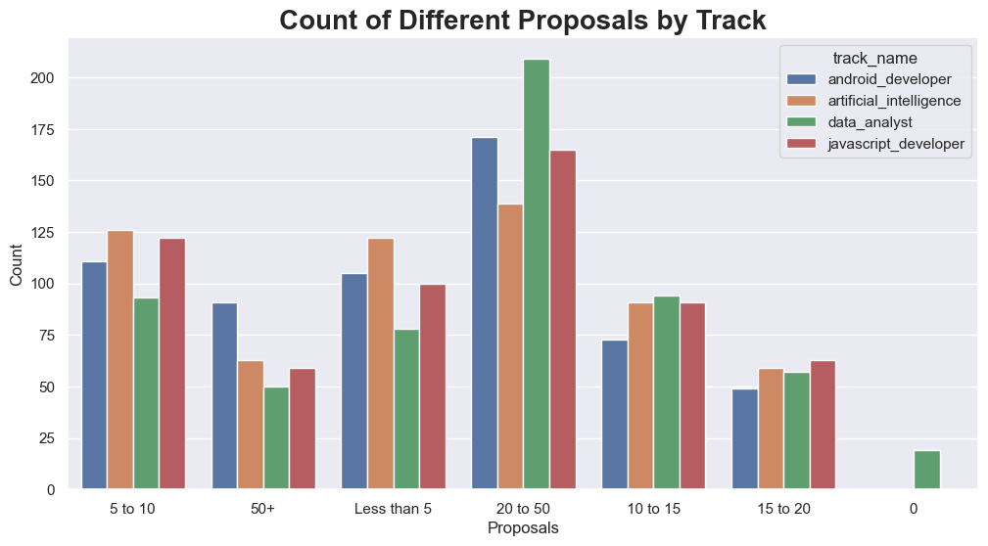

Slide 94
Insights
Most Jobs get between 20-50 Proposals regardless of job profile.

Slide 95
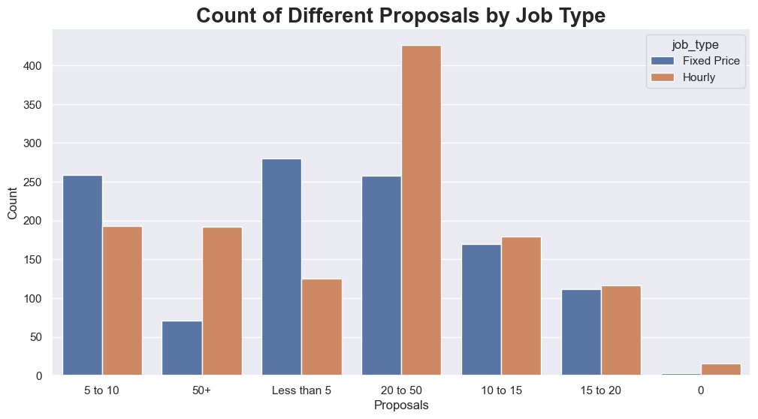

Slide 96
Insight
Hourly jobs get more proposals than Fixed-Price jobs.

Slide 97
Question
Does the Duration of Job Differ by Job Profile and/or Required Experience Level?

Slide 98
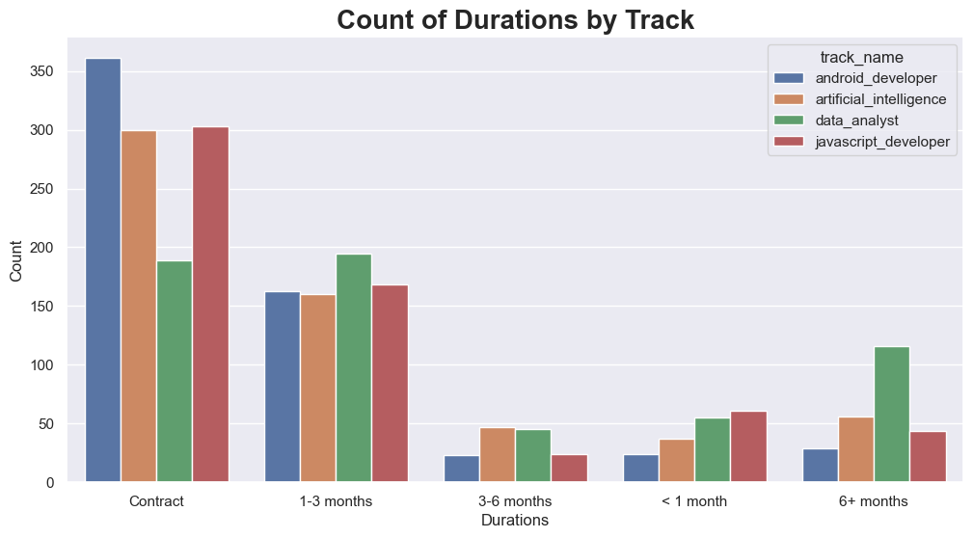

Slide 99
Insights
Most Hourly jobs require 1-3 months of work.
Many Data Analyst jobs require a working duration of 6+ months.

Slide 100
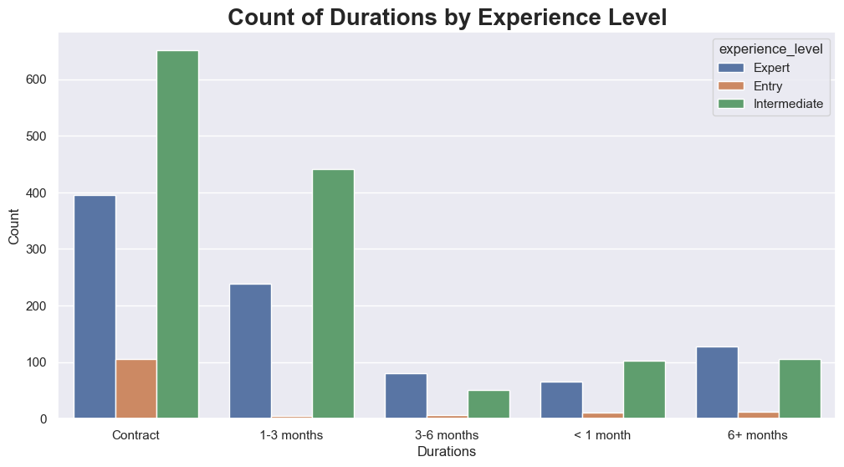

Slide 101
Insights
Most jobs for Entry levels are contractual.
For Intermediate and Expert levels, most jobs are either contractual or require 1-3 months of work.

Slide 102
Question
Do Work Hours Differ Depending on Job Profiles?

Slide 103
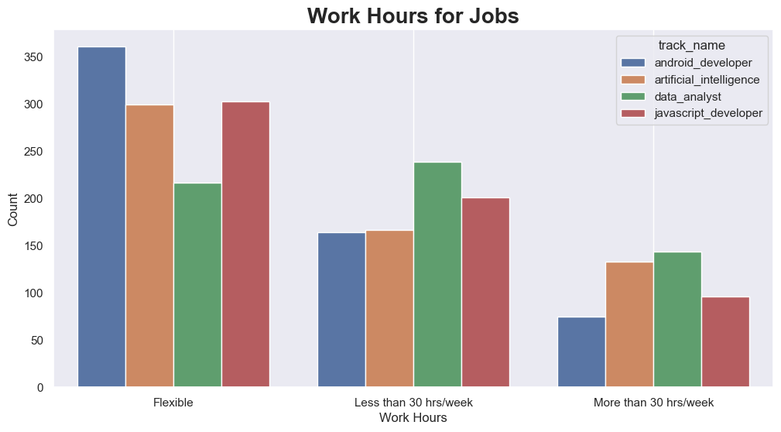

Slide 104
Insights
Most Hourly jobs require working less than 30 hrs/week.
There are more Hourly jobs for Data Analysts than Fixed-Price jobs.
There are more jobs with Flexible working hours for Android Developers.

Slide 105
Question
Are There More Clients From Certain Countries?

Slide 106
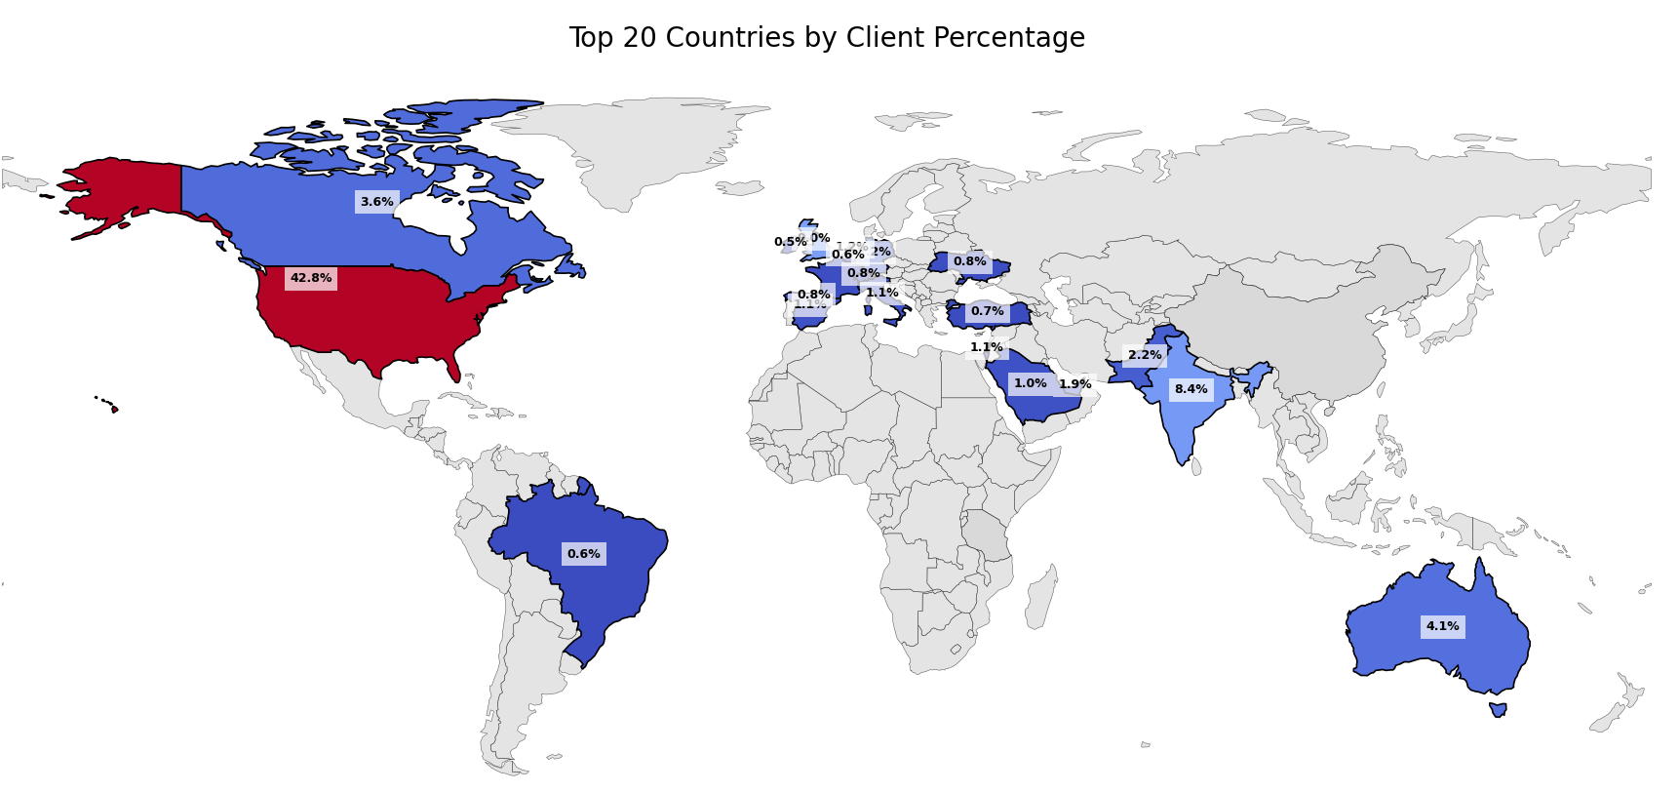

Slide 107
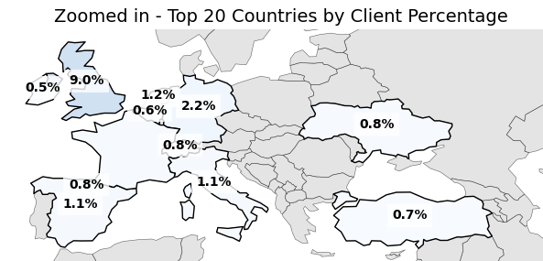

Slide 108
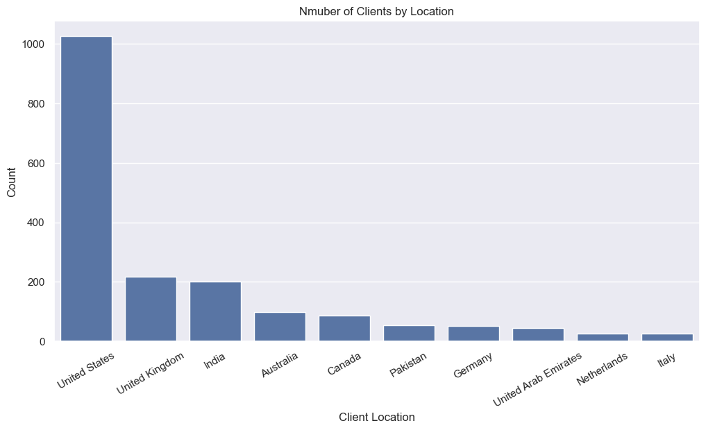

Slide 109
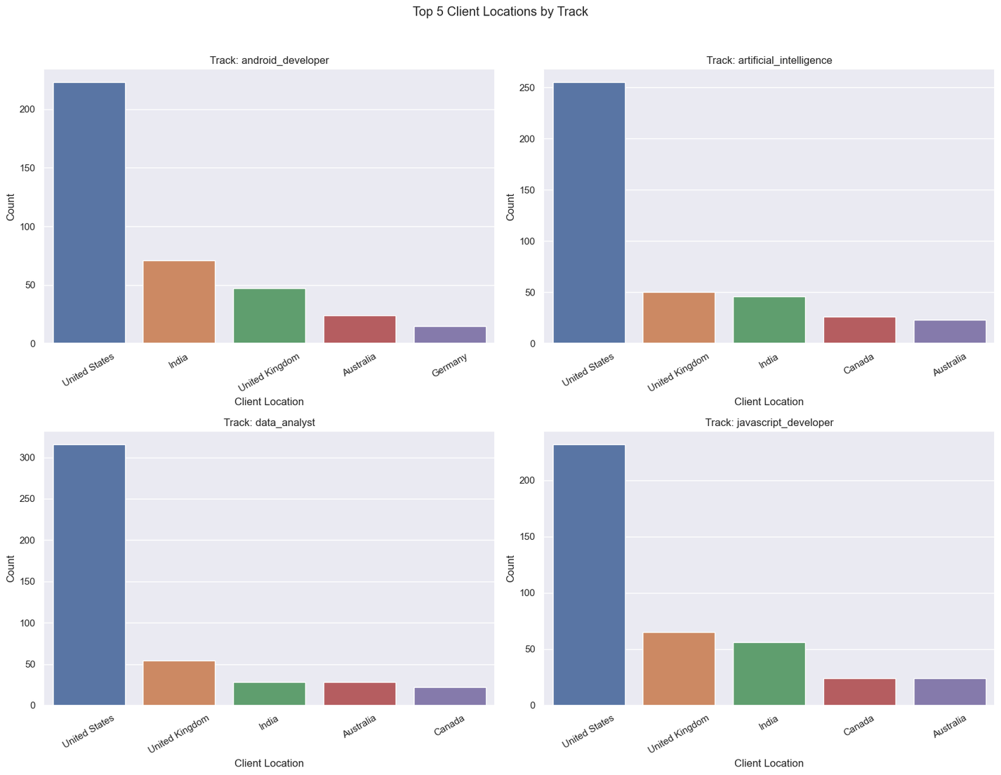

Slide 110
Insights
Top 3 client locations for all job profiles are:
United States
United Kingdom
India
4th and 5th place change between:
Australia
Canada
Germany

Slide 111
Question
By How Much Do Tracks Vary in Client Total Spending?

Slide 112
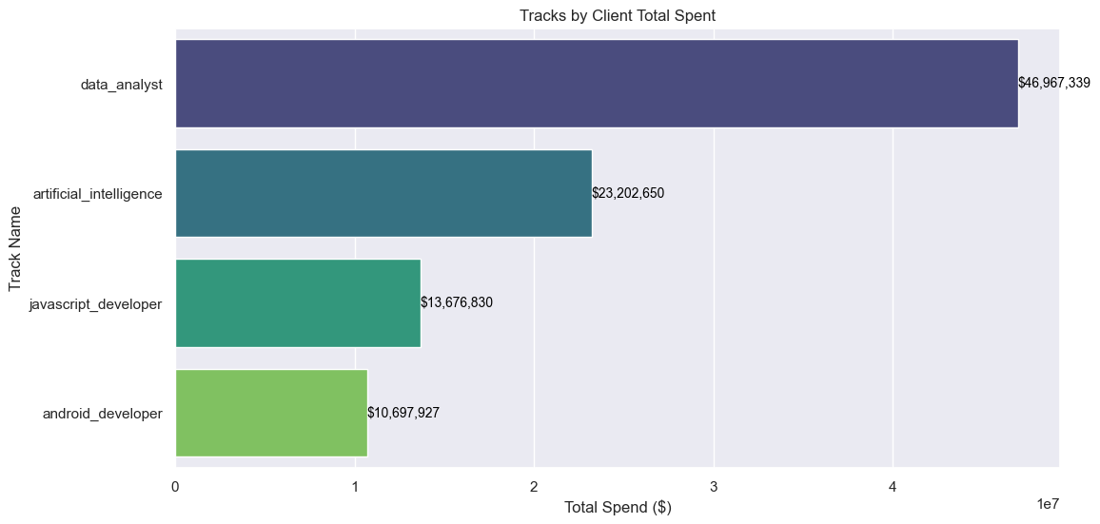

Slide 113
Question
By How Much Does Average Budget Vary?

Slide 114
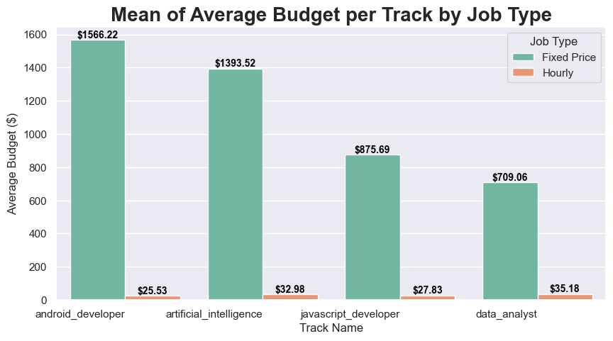

Slide 115
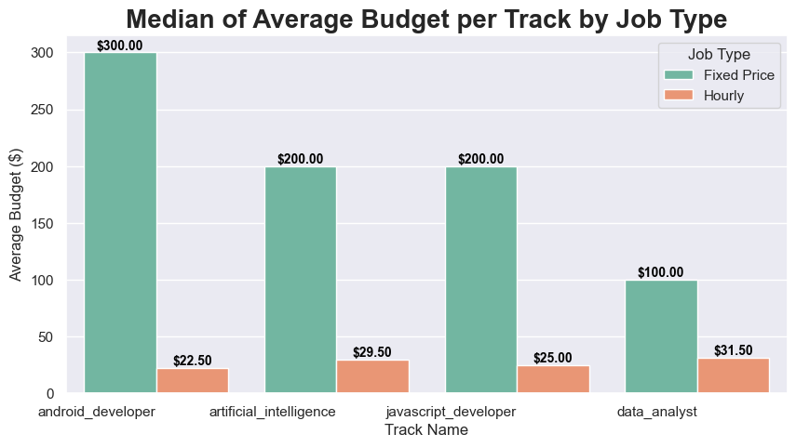

Slide 116
Insights
Through analyzing the mean and median of the average budgets for Hourly and Fixed-Price jobs, there appears to be huge outliers in the Fixed-Price category.

Slide 117
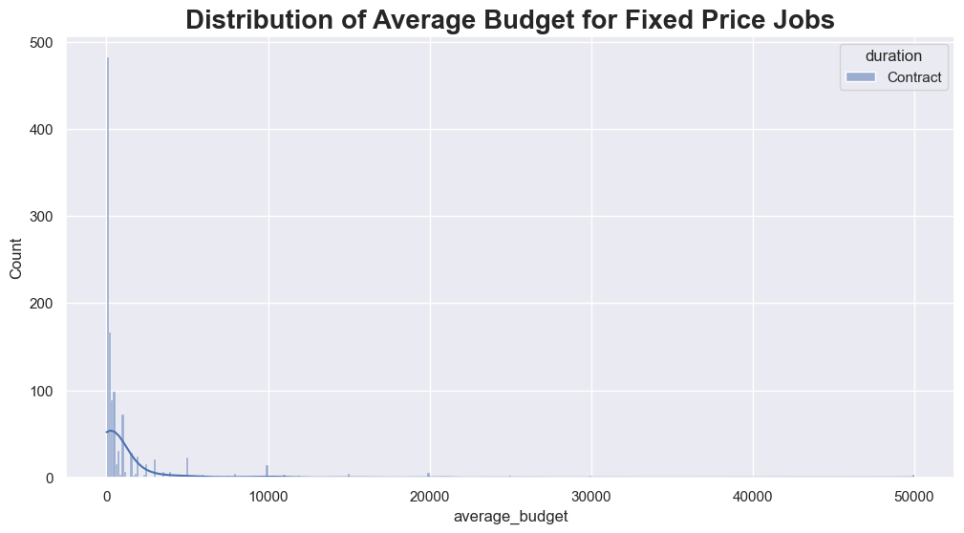

Slide 118
Insights
For Fixed-Price, most of the data is skewed left, with great outliers to the right.
These outliers could be because these salaries are for teams working on the project and not individuals.

Slide 119
Question
By How Much Do Top Required Skills Differ for Each Job Profile?

Slide 120
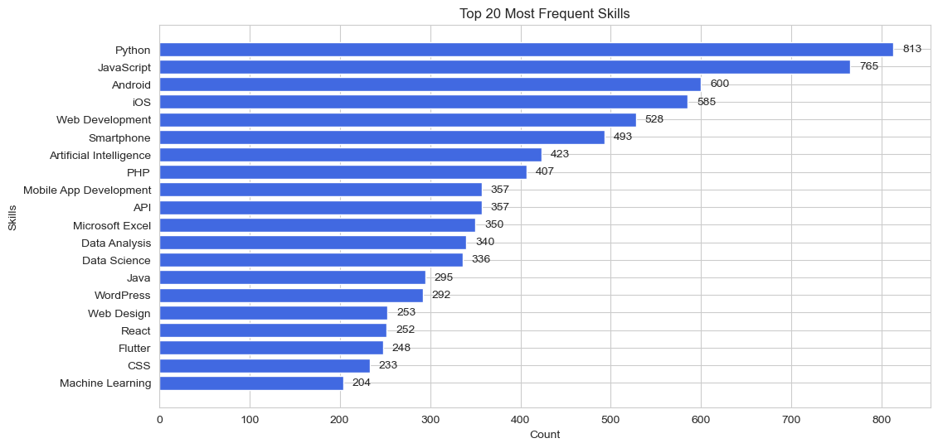

Slide 121
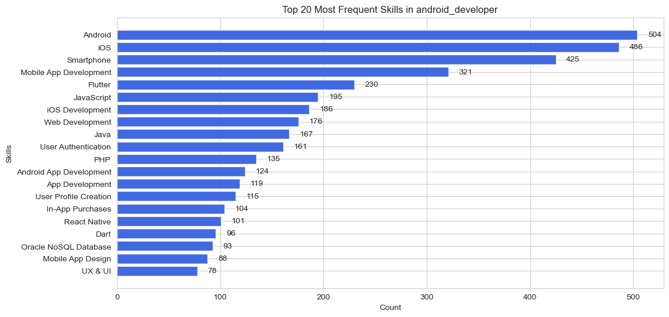

Slide 122
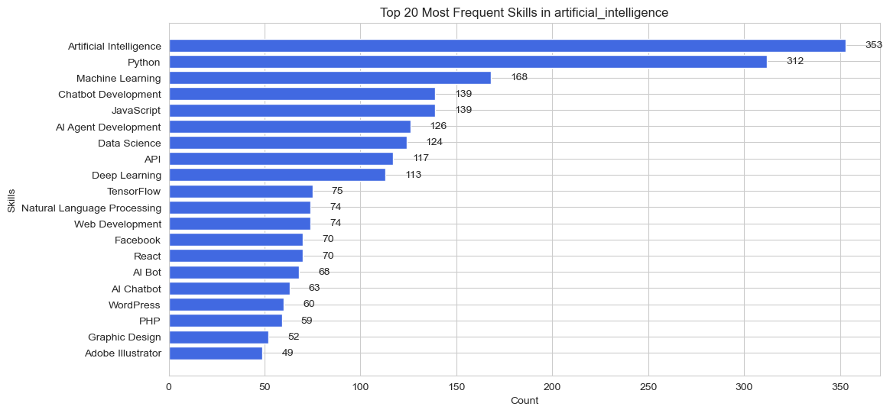

Slide 123
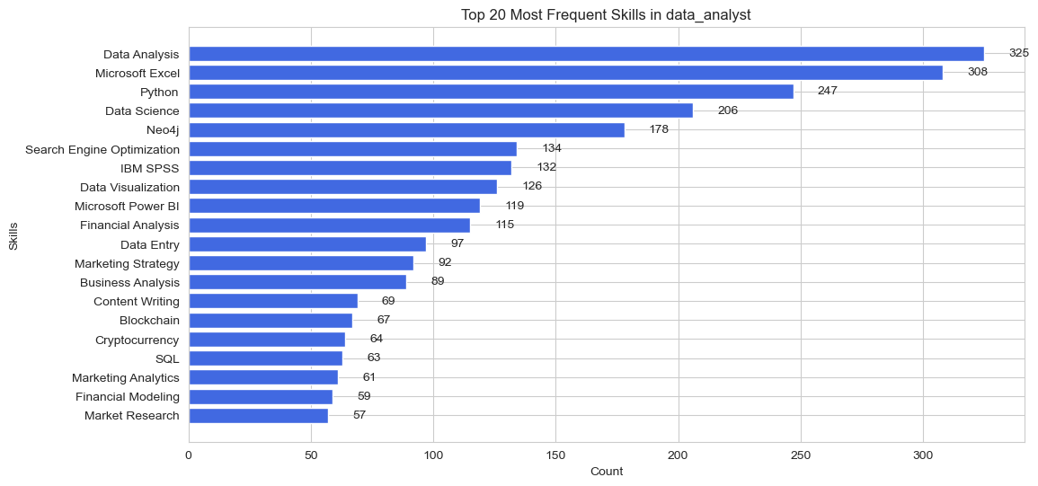

Slide 124
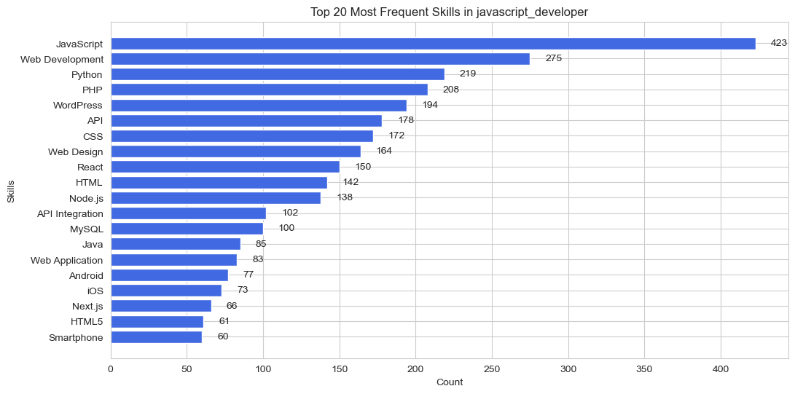

Slide 125
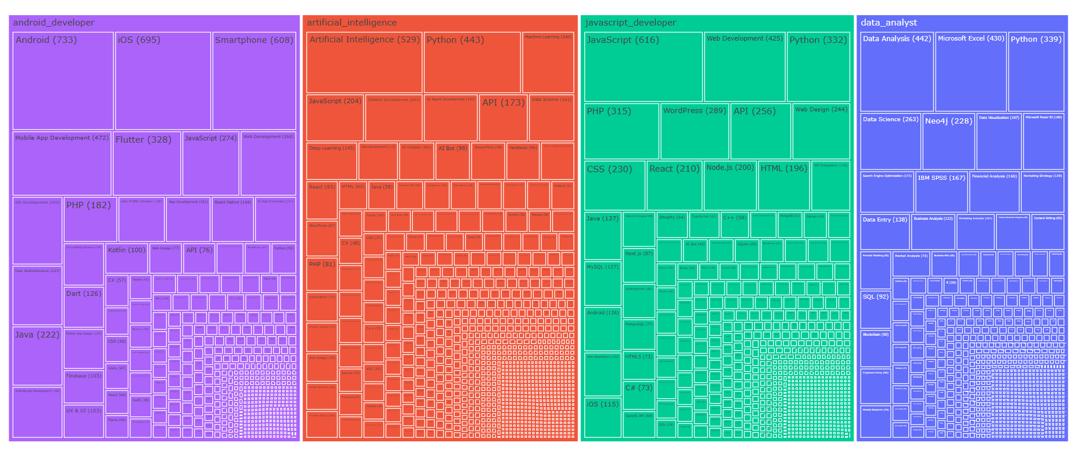
Treemap of Tracks and their Skills with Count

Slide 126
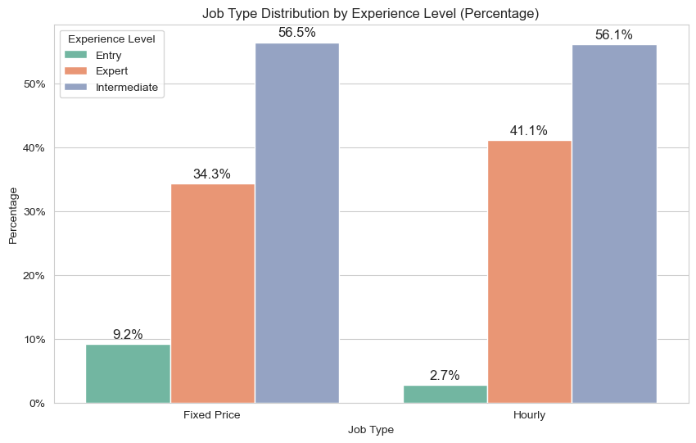

Slide 127
Insights
Job types are evenly split between experience levels

Slide 128
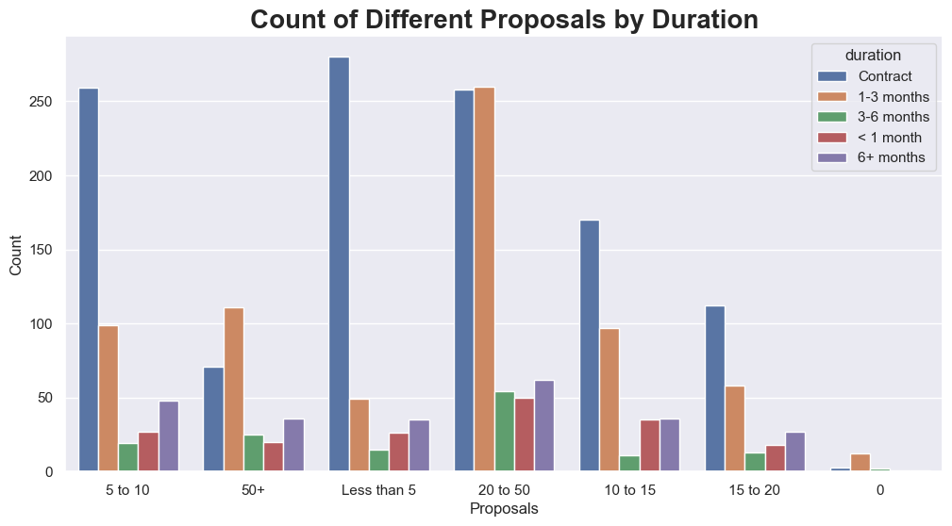

Slide 129
Insight
Jobs with contractual durations and those with duration of 1-3 months get the more proposals

Slide 130
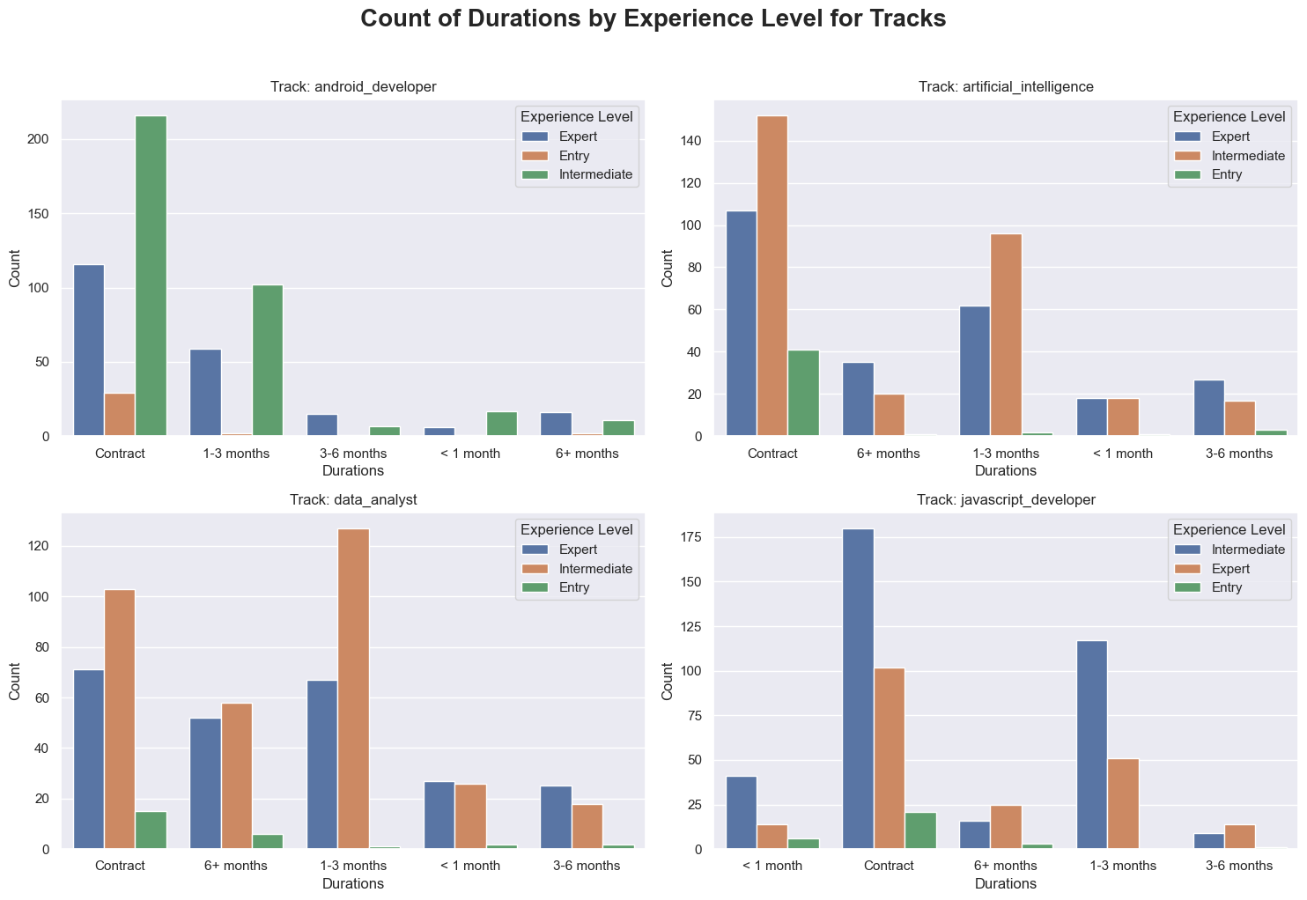

Slide 131
Insights
For Data Analysts, a lot of jobs may require 6+ months of work.
Other Job Profiles maintain previous trends.

Slide 132
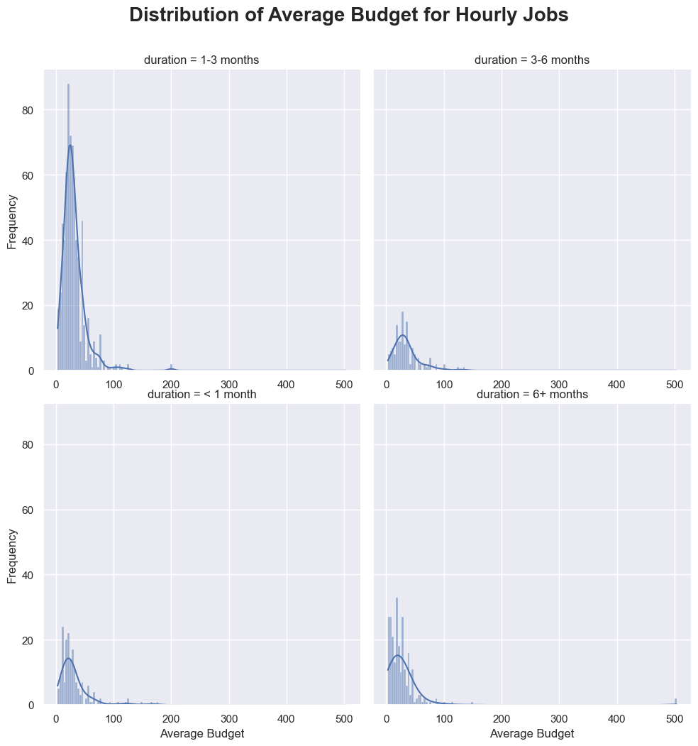

Slide 133
Insights
There are a greater number of hires between 1 and 100 for jobs with 1-3 months of work.

Slide 134
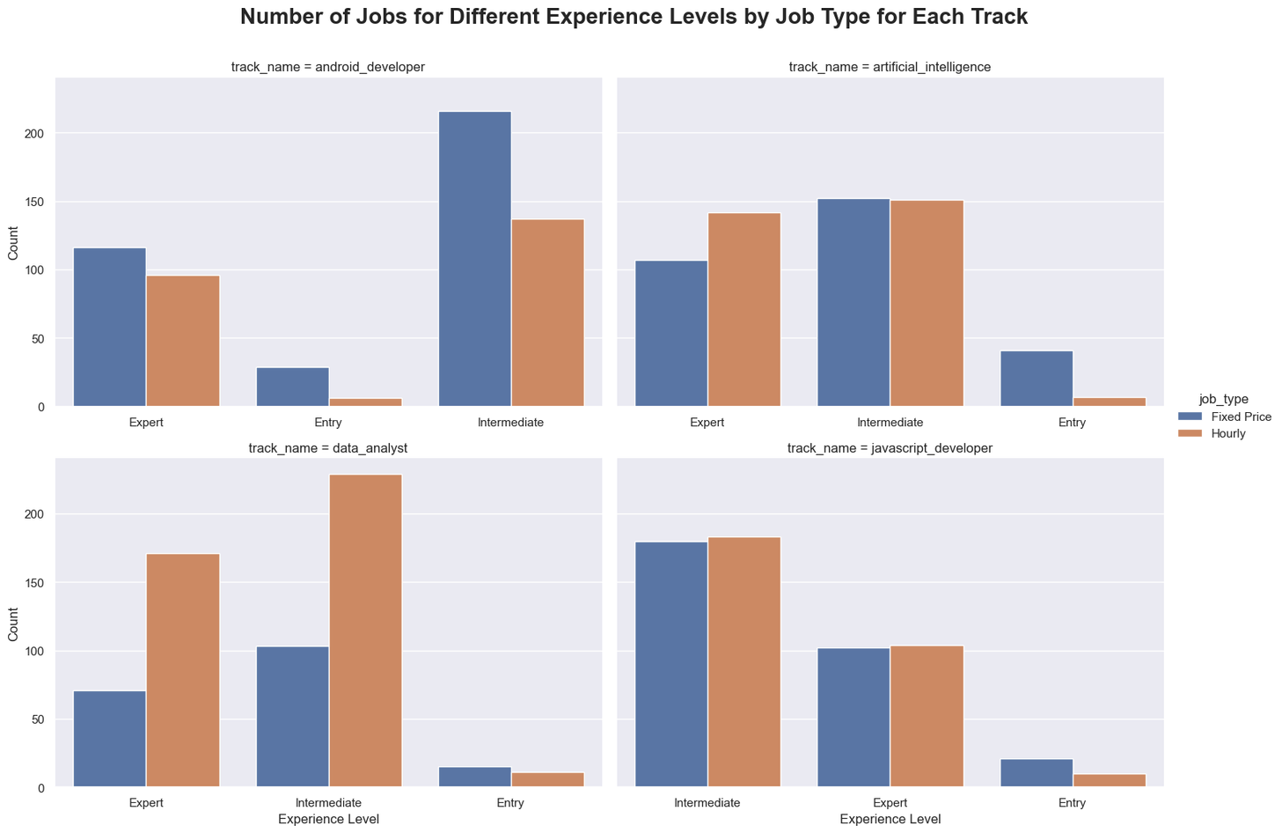

Slide 135
Entry Levels:
They get the least number of jobs for every job profile, with Fixed-Price jobs being more available to them.

Slide 136
Intermediate Levels:
In AI and JavaScript developers, number of jobs are similar for Fixed-Price and Hourly.
Data analysts get more Hourly jobs. Android developers get more Fixed-Price jobs.

Slide 137
Expert Levels:
JavaScript developers get same jobs for Fixed-Price and Hourly.
For AI and Data Analysts, they get more Hourly jobs.
Android Developers get more Fixed-Price jobs.

Slide 138
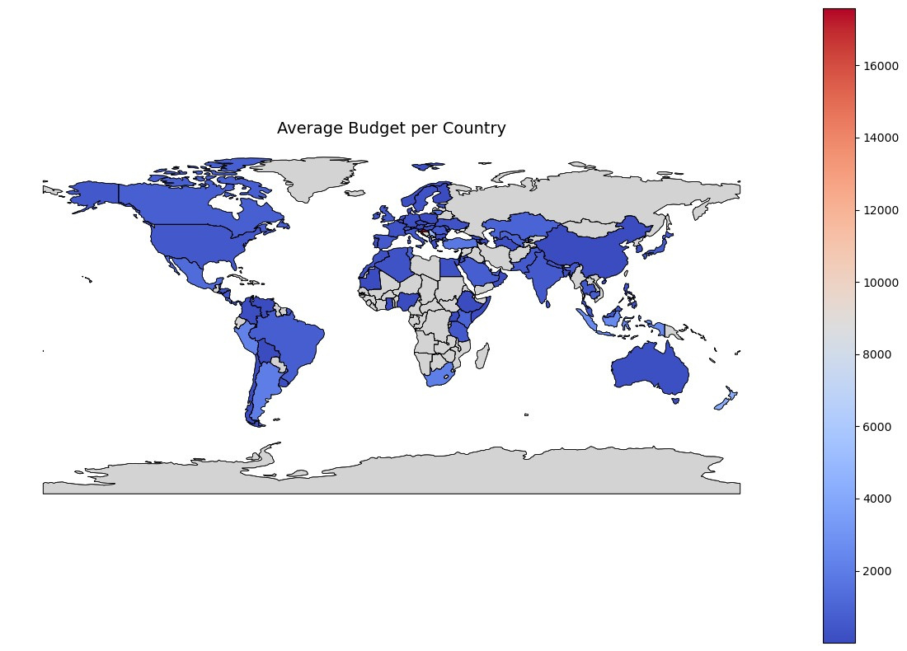

Slide 139

Limitations

Slide 140
Limitations
No access to time data
No information on the internals of the hiring process.
No access to data about applying freelancers.

Slide 141
Conclusion

Slide 142
Conclusion
Put at Least Intermediate as your Experience Level.
For AI Engineers, focus on NLP and Chatbot Development, also add APIs and Model Deployment to your skills.
For Data Analysts, focus on Business Intelligence and Finance.
For Android Developer, add iOS to your skill set.
For JavaScript Developers, focus on being as close to Full Stack Development as possible

Slide 143
THANK YOU
FOR YOUR NICE ATTENTION

